Slide 1
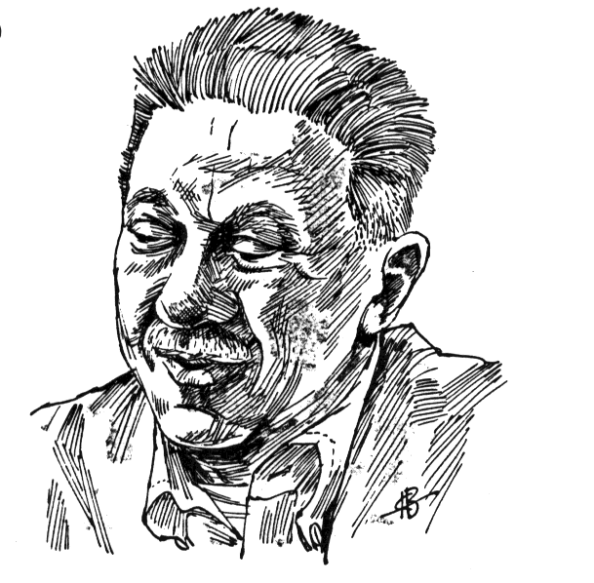
ABRAHAM MASLOW
was a leading humanistic psychologist (Third Force)
developed the Hierarchy of Needs
promoted the concept of self-actualization
was born in 1908, Brooklyn, New York

Slide 2
Hierarchy of Needs
growth
emotional
physical

Slide 3
Hierarchy of Needs
Physiological Needs

Slide 4
Physiological Needs
food
water
air
sleep

Slide 5

Food: A Most Powerful Need
South American Rugby team crashed in 1970
Food was the most pressing problem.
They ate human flesh for survival.
Even the strongest taboo was broken to fill the basic need for food.

Slide 6
Hierarchy of Needs
Safety Needs
Physiological Needs

Slide 7
Safety Needs
from physical attack
from emotional attack
from fatal disease
from invasion
from extreme losses (job, family members, home, friends)

Slide 8
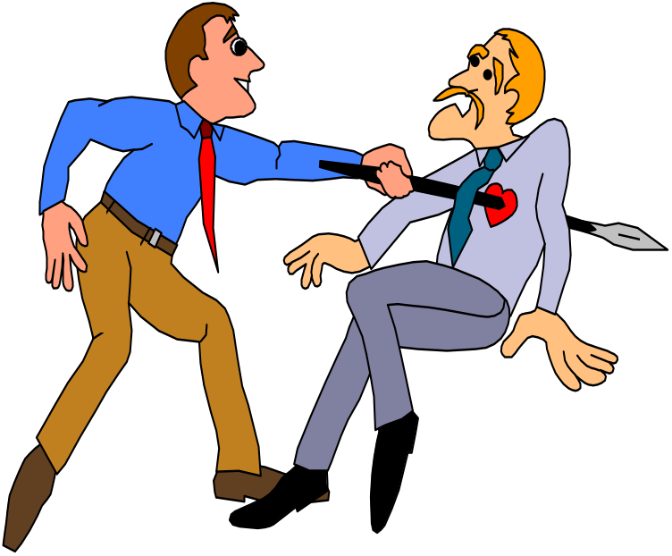
Safety: A Most Powerful Need
when frightened, our thoughts and energies are diverted
threat of, or actual attack creates “fight or flight” reaction
threats to safety can be physical or emotional

Slide 9
Hierarchy of Needs
Love & Belonging
Needs
Safety Needs
Physiological Needs

Slide 10
Love and Belonging
(social/emotional)
Inclusion - part of a group: colleagues, peers, family, clubs
Affection - love and be loved
Control - influence over others and self

Slide 11
Hierarchy of Needs
Esteem
Needs
Love & Belonging
Needs
Safety Needs
Physiological Needs

Slide 12
Esteem Needs
emotional (ego)
respect from others through: awards honors status
respect for self through: mastery achievement competence

Slide 13
Esteem from Self and Others:
A Most Powerful Need
Congratulations
You Have Done it.
You deserve it
You are amazing
All such attributes makes us proud and obviously our self esteem will be increased.

Slide 14
Hierarchy of Needs
B- Needs
(being)
Higher needs
Self-Actualization
Needs
Esteem
Needs
D- Needs
Deficit
Survival
Love & Belonging
Needs
Safety Needs
Physiological Needs

Slide 15
Some Self-Actualizing People from History
Abraham Lincoln
Thomas Jefferson
Mahatma Gandhi
Albert Einstein
Eleanor Roosevelt
William James
Benedict Spinoza

Slide 16
Self-Actualization Needs
stop cruelty and exploitation
encourage talent in others
try to be a good human being
do work one considers worthwhile
enjoy taking on responsibilities
prefer intrinsic satisfaction
seek truth
give unselfish love
be just

Slide 17
B-Needs of the Self-Actualized
Truth
Goodness
Beauty
Unity
Aliveness
Uniqueness
Perfection and Necessity
Completion
Justice and order
Simplicity
Richness
Effortlessness
Playfulness
Self-sufficiency
Meaningfulness

Slide 18
Qualities of the Self-Actualized
An non-hostile sense of humor
Intimate personal relationships
Acceptance of self and others
Spontaneity and simplicity
Freshness of appreciation
More peak experiences
Democratic values
Independence

